Slide 1
Capstone Project:
Automated Industrial Material Storage And Delivery System
Group 5
Aishwary Panchal ESE 7224347
Abdelrahman Abdin Mousa Abdin ESE 7223296
Girsy Guzmán Garcia ESE 7224626

Slide 2
Role
Distribution
Smart Storage Management System: Abdelrahman Abdin
Charging Stations: Girsy Guzmán and Abdin
Task management system: Girsy Guzmán
Human Machine Interface: Aishwary Panchal
File logging operations: Aishwary Panchal

Slide 3
Domain Description
A system to store raw materials as well as processed goods.
Fully automated for storage handling and moving of materials within the warehouse.
The key components of the system are the task management system, the storage management system and a human machine interface to create and manage the orders.
The system allows to create orders, view the logs of the different systems, view status of vehicles, charging station and inventory in the GUI.
This would fit a raw material processing industry, like raw iron ore processing

Slide 4
System requirements
To ensure the system works perfectly, the material first needs to be sent to the warehouse for storage using the "toWarehouse" order type. Once inventory is updated, the other operations can be carried out
Subsequent operations like "toFactory" and "toDelivery" need to be executed with weight quantities lesser than the weights present in the inventory
To run unit tests, Junit must be added to the classpath in the build path of the project
To run the GUI, Javafx must be added to the project. There are 2 main ways of doing this:
  Add Javafx libraries manually to the classpath in the build path, OR
  Make use of a JDK that has Javafx already bundled with it

Slide 5
Class diagram
Automated Industrial Material Storage And Delivery System
Group 5

Slide 6
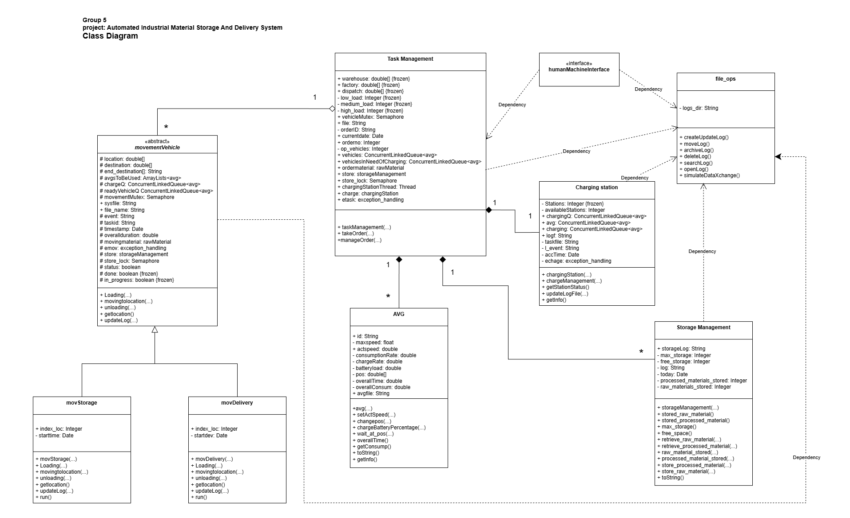

Slide 7
Component diagram
Automated Industrial Material Storage And Delivery System
Group 5

Slide 8
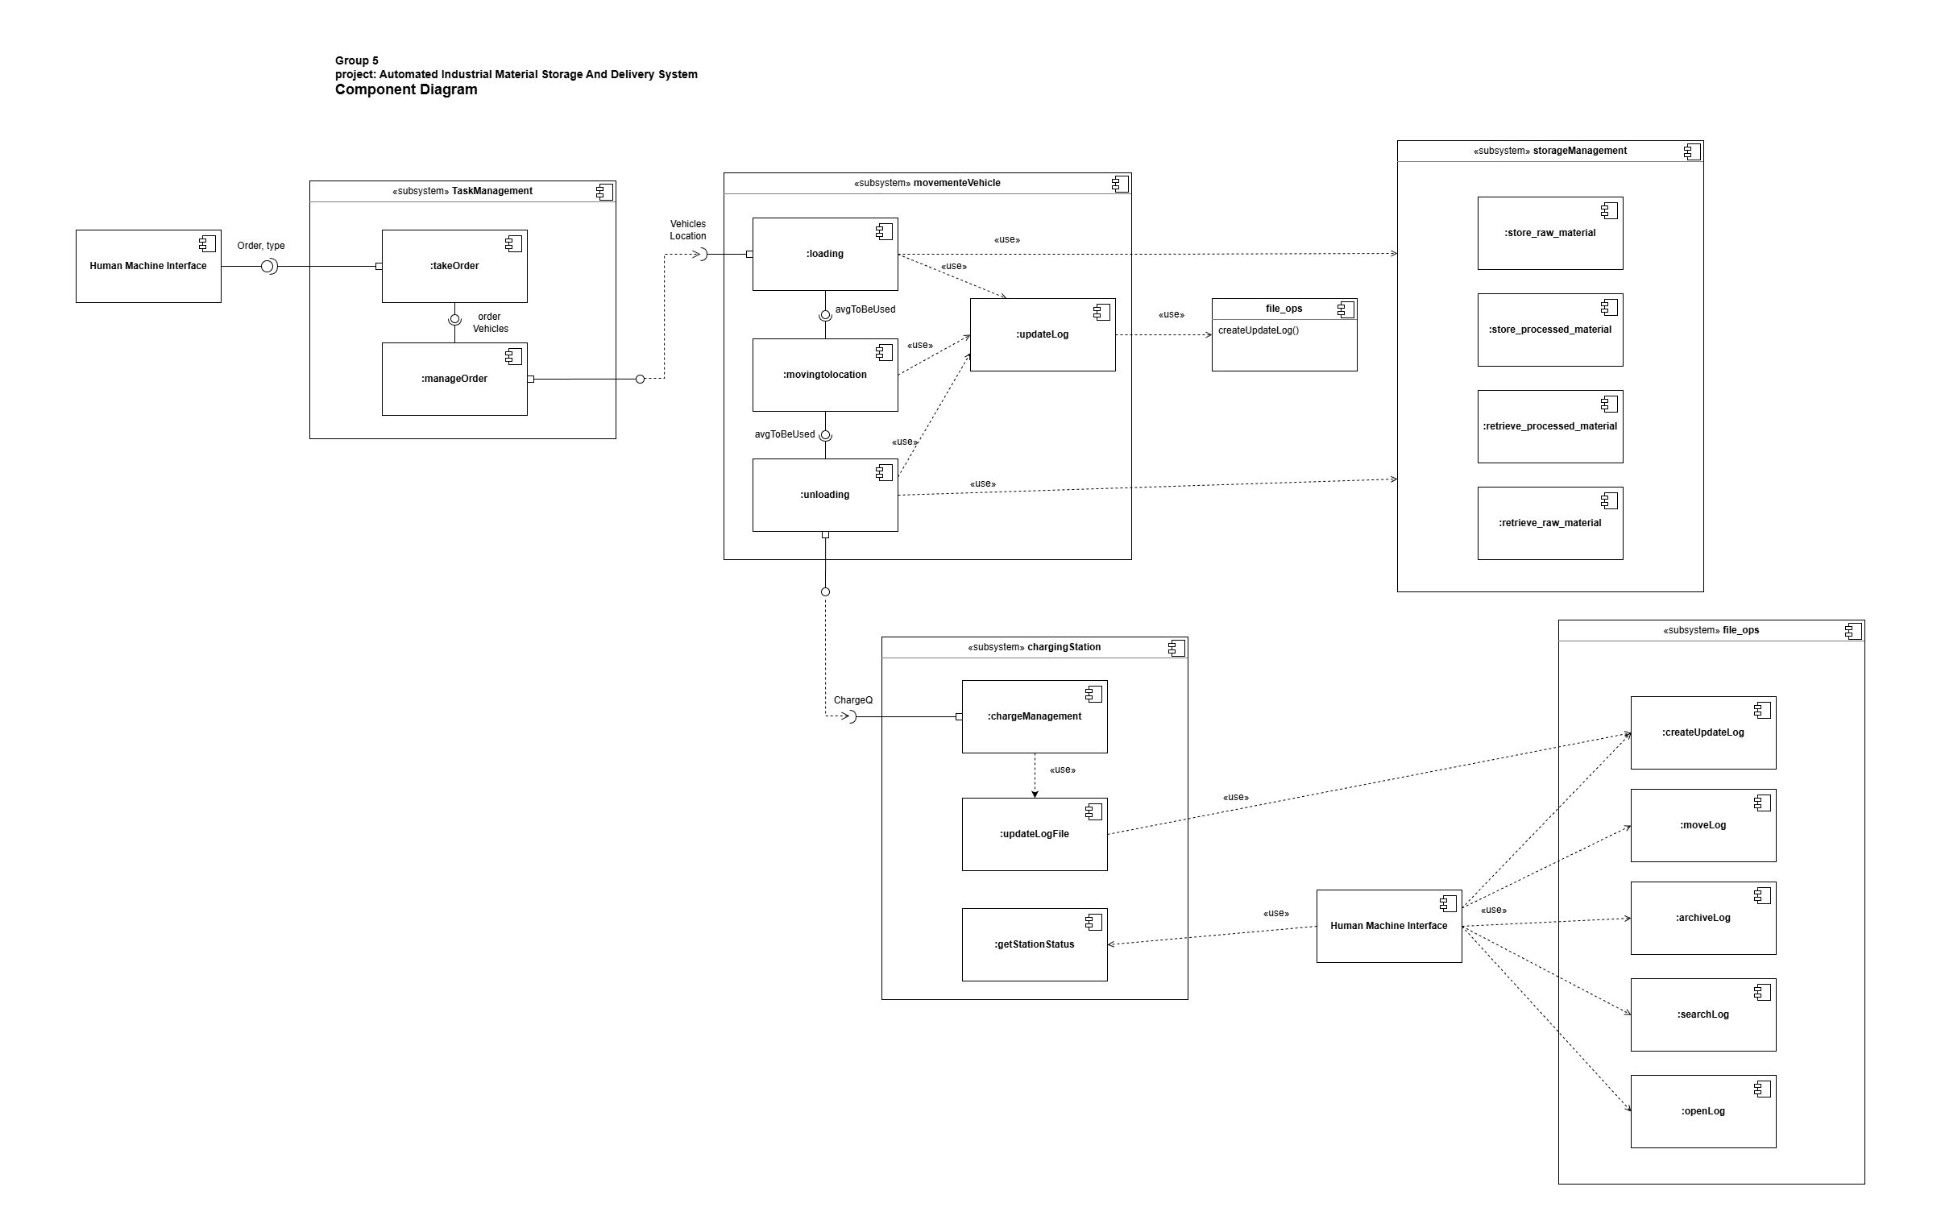

Slide 9
Management I/O
User input: weight entered with "toWarehouse" type selected. ("toFactory" and "toDelivery" can be selected once inventory for raw materials and processed goods are non-zero respectively)
Task Management spawns different threads for the charging station, movDelivery and movStorage.
Two queues are also created for the available avgs as well as the avgs in need of charging.
Data from charging station and inventory is updated periodically as orders are created
Vehicle and charging station events are logged as new events take place.
An error pop up opens when order weight being sent to factory or for delivery exceeds the inventory stock

Slide 10
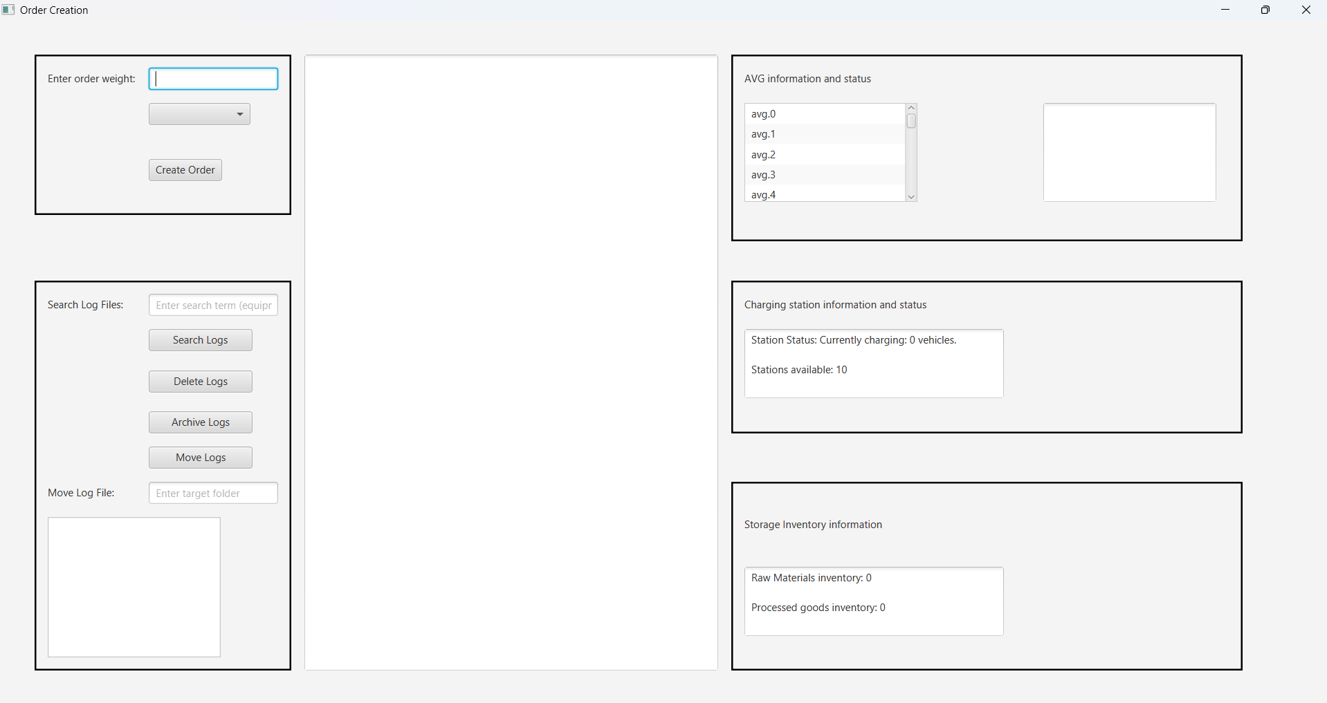
User interface

Slide 11
Concurrency and threads
Charging concurrency
The charging management class (chargingStation) is runnable and is spawned as a separate thread by the task management class.
Movement classes
The "movStorage" and "movDelivery" classes are runnable and are executed as separate threads by the task management class when an order needs to be handled.
Storage class
The “storageManagement” class is not itself threaded, however all the methods that interact with the storage use the synchronized keyword, making them thread safe, so they can be used by the movement classes safely.

Slide 12
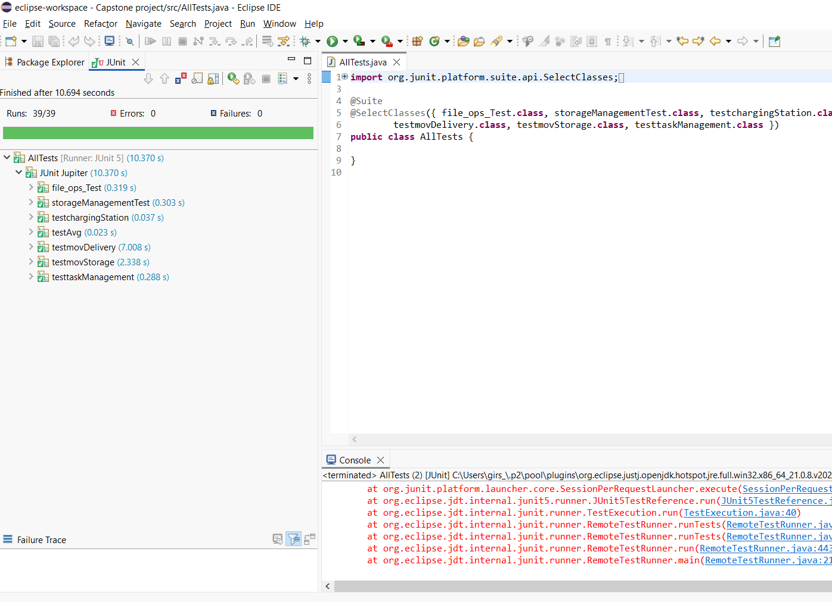
Unit test results

Slide 13
Thank you
Group 5
Automated Industrial Material Storage And Delivery System

